Slide 1


Viren Patel
May 24, 2024

Slide 2

Outline
Executive Summary
Introduction
Methodology
Results
Conclusion

Slide 3
Executive Summary
Using the CRISP-DM methodology process we were able to:
Understand the Data from SpaceX
Prepare the data by cleaning it
Create models with the clean data
Test the models with the clean data
Used the models to evaluate the data from SpaceX to determine which launching site had the highest success rate

Slide 4
Introduction
SpaceX send manned missions to space, send spacecraft to the International Space Station and to Starlink
Rocket launches are relatively inexpensive
SpaceX can reuse the first stage allowing them to save money.
If we can determine if the first stage will land, we can determine the cost of a launch
We want to determine the price of each launch
Also determine if the first stage will land successfully

Slide 5


Slide 6
Methodology
Executive Summary
Data collection methodology:
The data was collected with the SpaceX REST API
Perform data wrangling
Convert outcomes to Classes y: 0 for bad outcome, 1 for good outcome
Perform exploratory data analysis (EDA) using visualization and SQL
Perform interactive visual analytics using Folium and Plotly Dash
Perform predictive analysis using classification models

Slide 7
Data Collection – SpaceX API
Functions were created to help us use the API to extract information using identification numbers in the launch data.
After all the data was collected using the GET request the data needed to be filtered to only contain Falcon 9 launches
Replace missing values in PayloadMass
GitHub URL of the completed SpaceX API calls notebook
Import libraries and define auxiliary functions
Request and parse the SpaceX launch data using the GET request
Filter the data frame to only include Falcon 9 launches
Deal with the missing values

Slide 8
Create helper functions to process web scraped HTML table
Request the Falcon9 launch Wiki page from its URL
Extract all column/variable names from the HTML table header
Create a data frame by parsing the launch HTML tables
Fill up a dictionary with launch records extracted from table rows
Create a dataframe from the dictionary
Data Collection - Scraping
GitHub URL of completed web scraping notebook
Using web scraping we requested the Falcon9 launch data. Extracted the data and put it into a data frame.

Slide 9
Calculate the number of launches on each site
Calculate the number and occurrence of each orbit
Calculate the number and occurrence of mission outcome per orbit type
Create a landing outcome label from Outcome column
Data Wrangling
There are several different cases where the booster did not land successfully. We needed to convert those outcomes into Training labels 1 for success and 0 for unsuccessful.
GitHub URL of completed data wrangling related notebooks

Slide 10
EDA with Data Visualization
The charts used on the data were scatter plots, bar chart and line chart.
Scatter plots were used to visualize the relationships between: Flight number vs Pay load Mass, Flight number vs Launch Site, Pay Load vs Launch Site, Flight number vs Orbit type and Pay load vs Orbit type.
Bar chart was used to visualize the relationship between success rate of each orbit type
Line chart was used to visualize the launch success yearly trend
GitHub URL of completed EDA with data visualization notebook

Slide 11
EDA with SQL
Using bullet point format, summarize the SQL queries you performed
Add the GitHub URL of your completed EDA with SQL notebook, as an external reference and peer-review purpose

Slide 12
Build an Interactive Map with Folium
We marked all the launch sites on a map with circles.
Each site had both success and failed launches, so we enhanced the map by adding launch outcomes for each site.
Red Markers for unsuccess and green markers for successful launches.
We also calculated the distance between a launch site to its proximities
Railways, Highways, coast lines and other cites.
GitHub URL of completed interactive map with Folium map.

Slide 13
Build a Dashboard with Plotly Dash
Using plotly we created both a pie chart and a scatter plot.
The pie chart was used to visualize the success rate of launches by site.
The scatter plot was used to visualize the correlation between payload and success for all sites.
GitHub URL of completed Plotly Dash lab

Slide 14
Predictive Analysis (Classification)
We used 4 different classification models: Logistic regression, support vector machine, decision tree classifier and k nearest neighbor
After training and testing each model it was determined that the decision tree classifier yielded the highest accuracy.
GitHub URL of completed predictive analysis lab.
Create a Numpy arry from the column Class in data
Standardize the data in X. Use the function train_test_split to split the data X and Y
Create logistic regression object, train and test
Create support vector machine object, train and test
Create decision tree classifer object, train and test
Create k nearest neighbors object, train and test
Find maximum accuracy to determine which method performs best

Slide 15
Results
Exploratory data analysis results
Interactive analytics demo in screenshots
Predictive analysis results

Slide 16


Slide 17
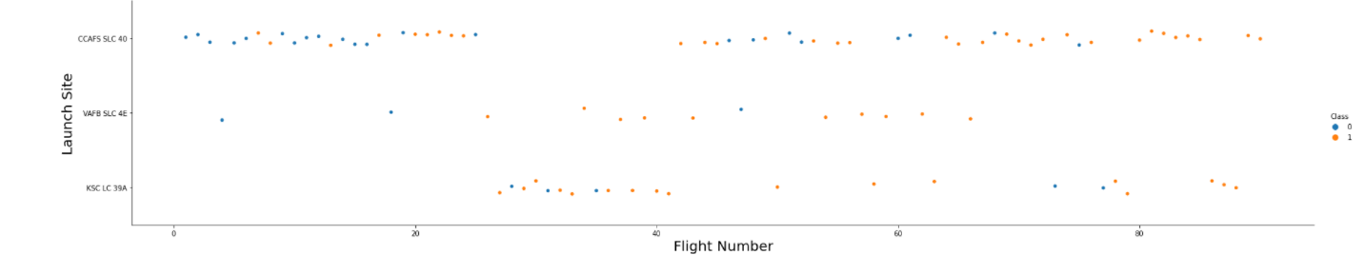
Flight Number vs. Launch Site
We see that the different launch sites have different success rates. CCAFS LC-40, has a success rate of 60% while KSC LC-39-A and VAFB SLC 4E has a success rate of 77%.

Slide 18
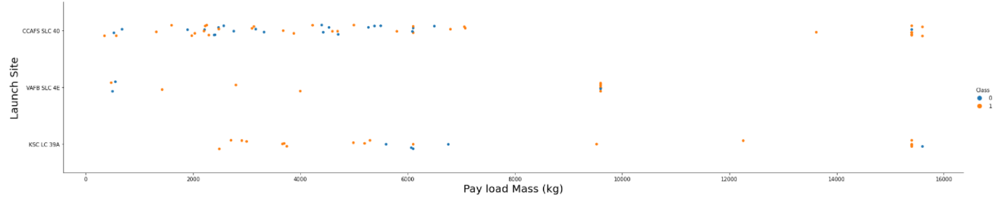
Payload vs. Launch Site
Now if you observe Payload Vs. Launch Site scatter point chart you will find for the VAFB-SLC launch site there are no rockets launched for heavy payload mass(greater than 10000).

Slide 19
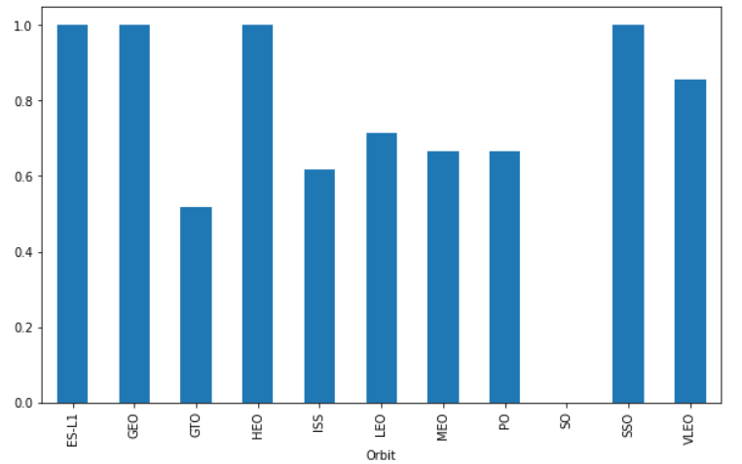
Success Rate vs. Orbit Type
ES-L1, GEO, HEO and SS0 orbits all have the highest success rates.

Slide 20
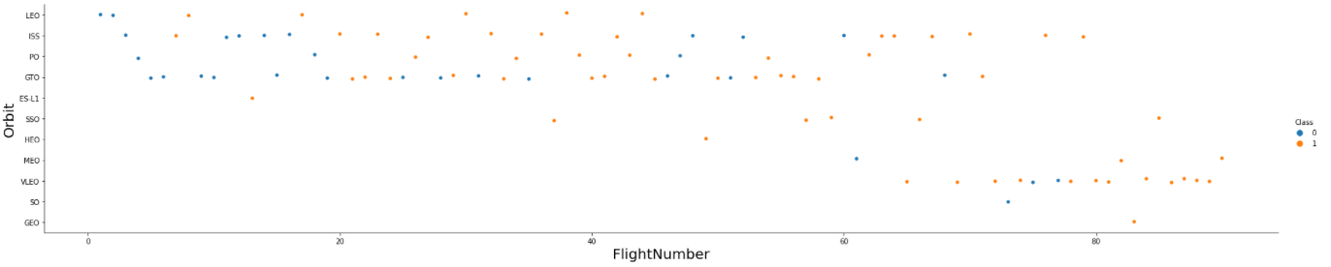
Flight Number vs. Orbit Type
You should see that in the LEO orbit the Success appears related to the number of flights; on the other hand, there seems to be no relationship between flight number when in GTO orbit.

Slide 21
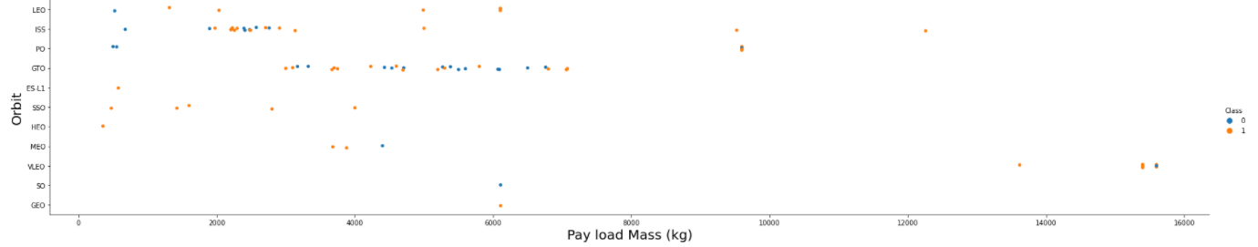
Payload vs. Orbit Type
With heavy payloads the successful landing or positive landing rate are more for Polar,LEO and ISS.
However for GTO we cannot distinguish this well as both positive landing rate and negative landing(unsuccessful mission) are both there here.

Slide 22
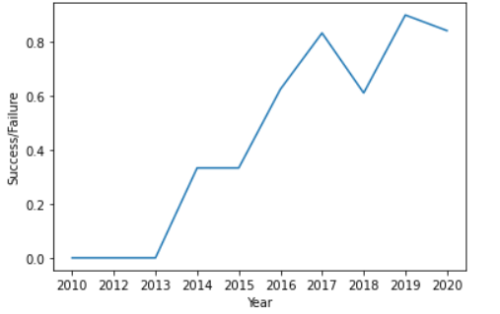
Launch Success Yearly Trend
You can observe that the success rate since 2013 kept increasing till 2020

Slide 23
All Launch Site Names
SQL was used to find the Site Names:
CCAFS LC-40
CCAFS SLC-40
KSC LC-39A
VAFB SLC-4E

Slide 24
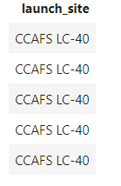
Launch Site Names Begin with 'CCA'
5 records where launch sites begin with `CCA`

Slide 25
Total Payload Mass
The total payload mass carried by boosters launched by NASA (CRS) is 619967kg

Slide 26
Average Payload Mass by F9 v1.1
The average payload mass carried by booster version F9 v1.1is 6138kg

Slide 27
First Successful Ground Landing Date
The first successful landing outcome on ground pad was on 2010-06-04

Slide 28
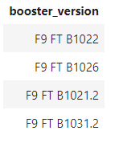
Successful Drone Ship Landing with Payload between 4000 and 6000
The names of boosters which have successfully landed on drone ship and had payload mass greater than 4000 but less than 6000

Slide 29
Total Number of Successful and Failure Mission Outcomes
The total number of successful outcomes is 100 and the total number of failure mission outcomes is 1

Slide 30
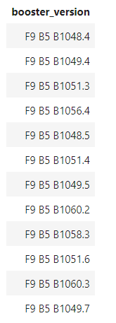
Boosters Carried Maximum Payload
The names of the booster which have carried the maximum payload mass

Slide 31
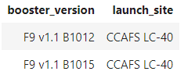
2015 Launch Records
The failed landing outcomes in drone ship, their booster versions, and launch site names for in year 2015

Slide 32
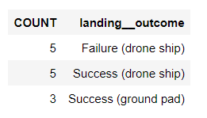
Rank Landing Outcomes Between 2010-06-04 and 2017-03-20
The count of landing outcomes (such as Failure (drone ship) or Success (ground pad)) between the date 2010-06-04 and 2017-03-20, in descending order

Slide 33


Slide 34
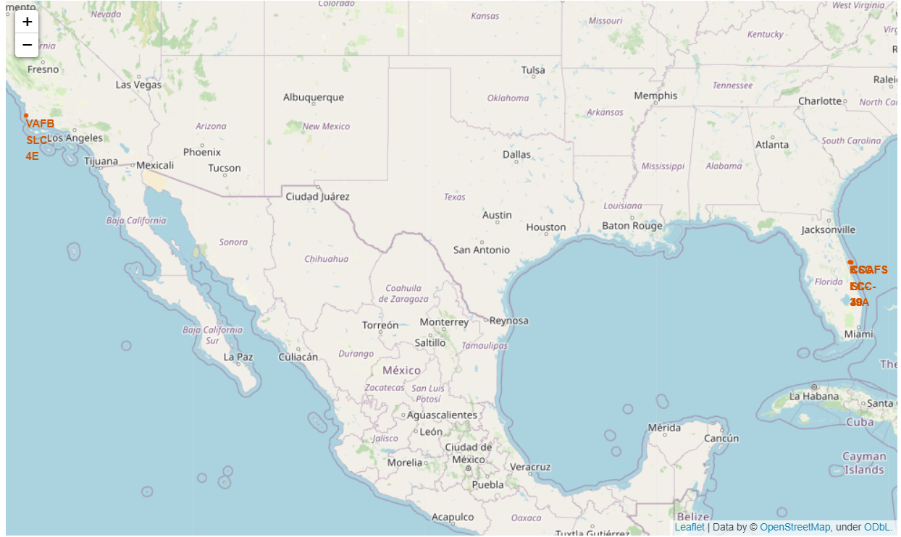
Launch Sites Map
Below is a map of the launch Sites on a Folium map using the data frame launch sites.

Slide 35
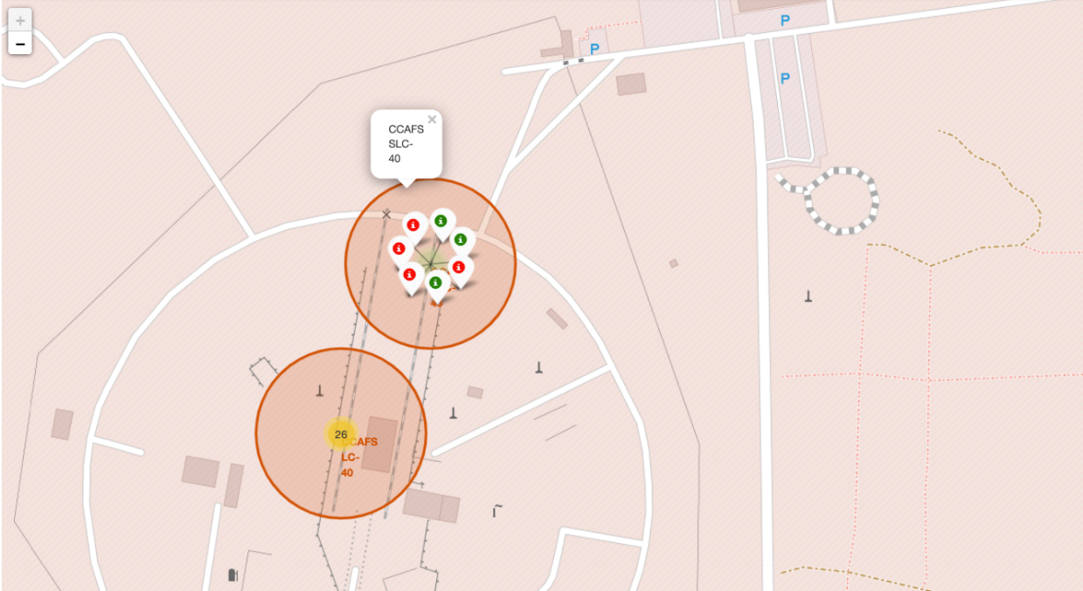
Launch Outcomes Map
From the color-labeled markers in the marker cluster, you can easily identify which launch sites have a relatively high success rate.

Slide 36
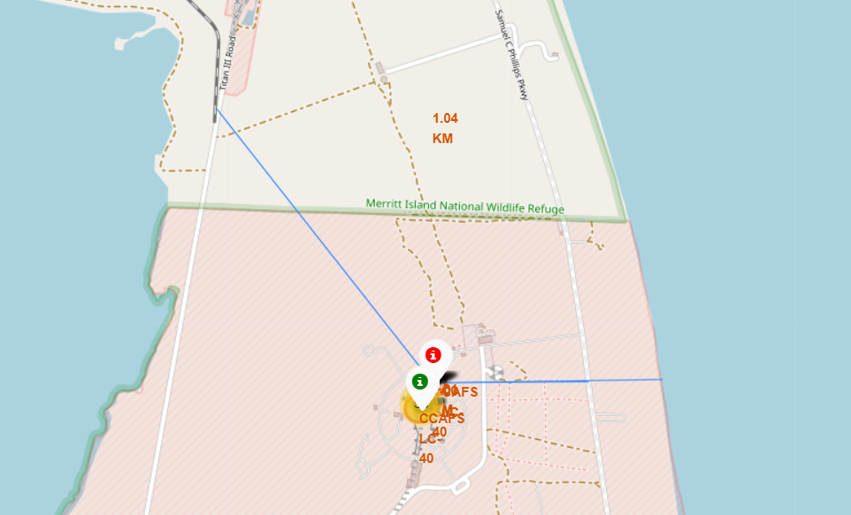
Launch Site to its proximites
This map shows the Launch site in proximity to the nearest Railway which is 1.036 km away
Also, the closest major city is 195 km away

Slide 37


Slide 38
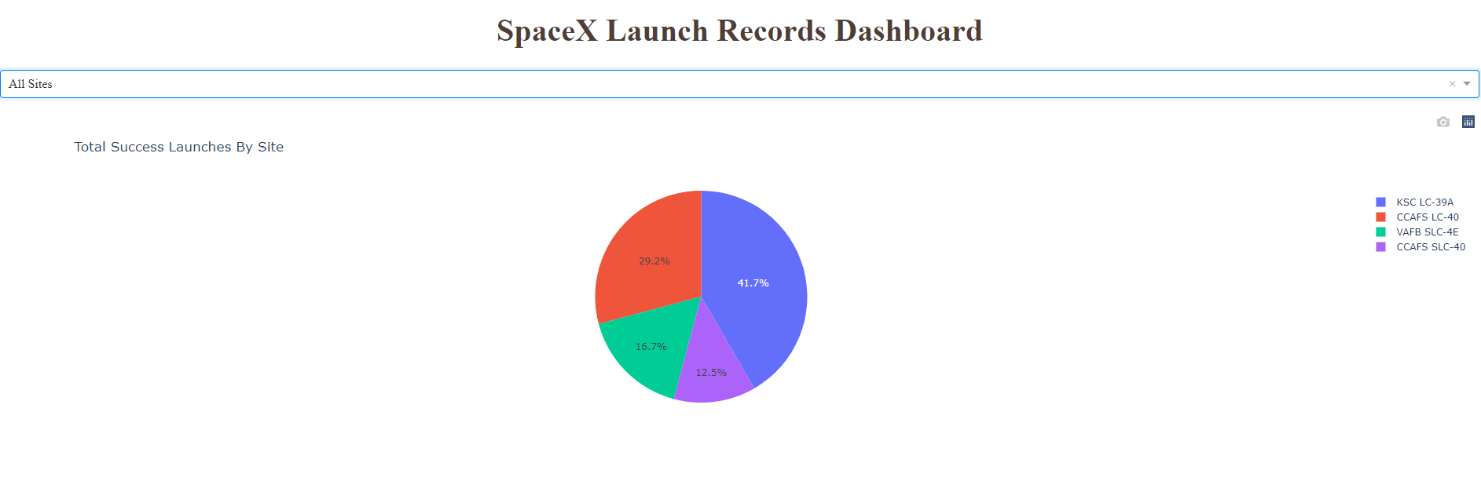
Pie Chart of launch success
This pie chart shows the success percentage of each of the launch sites. KSC LC-39A has the highest percentage of 41.7% success

Slide 39
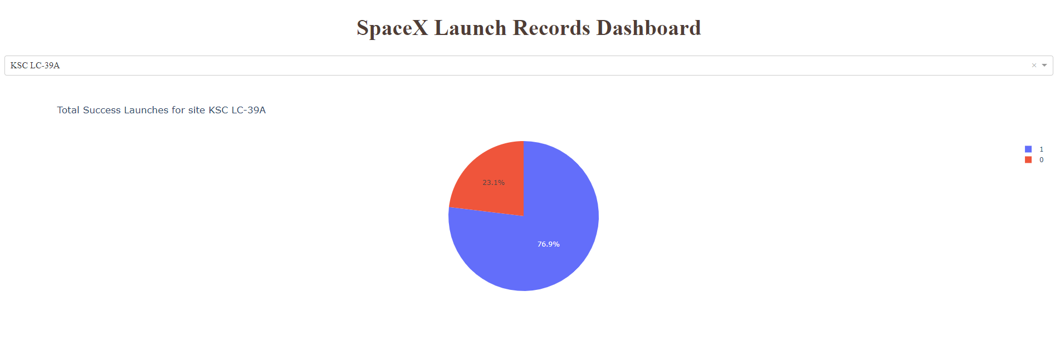
Highest launch success ratio
When measuring success vs failure. KSC LC-39A has a success rate of 76.9% and a failure rate of 23.1%

Slide 40
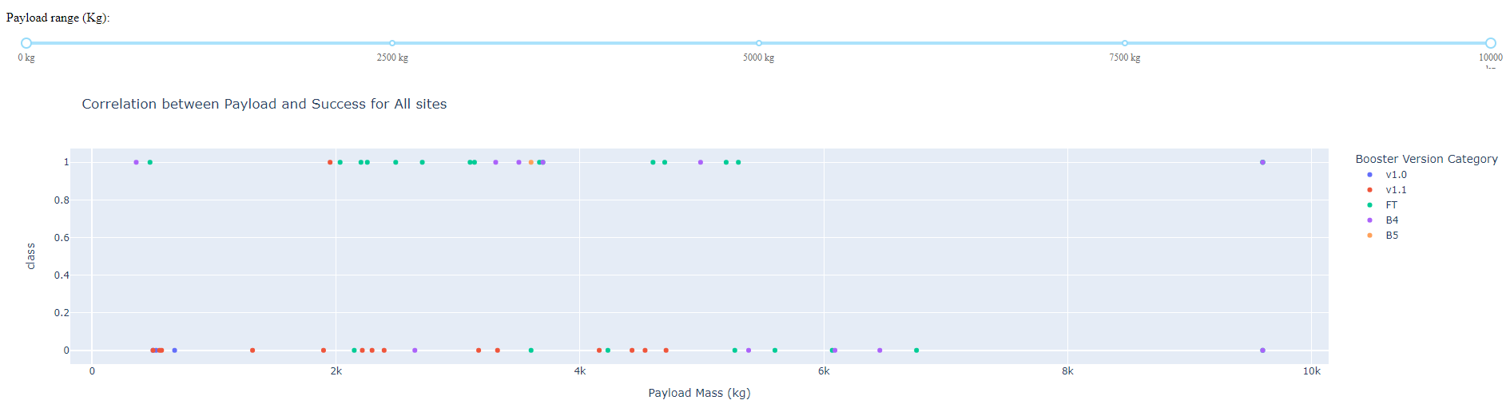
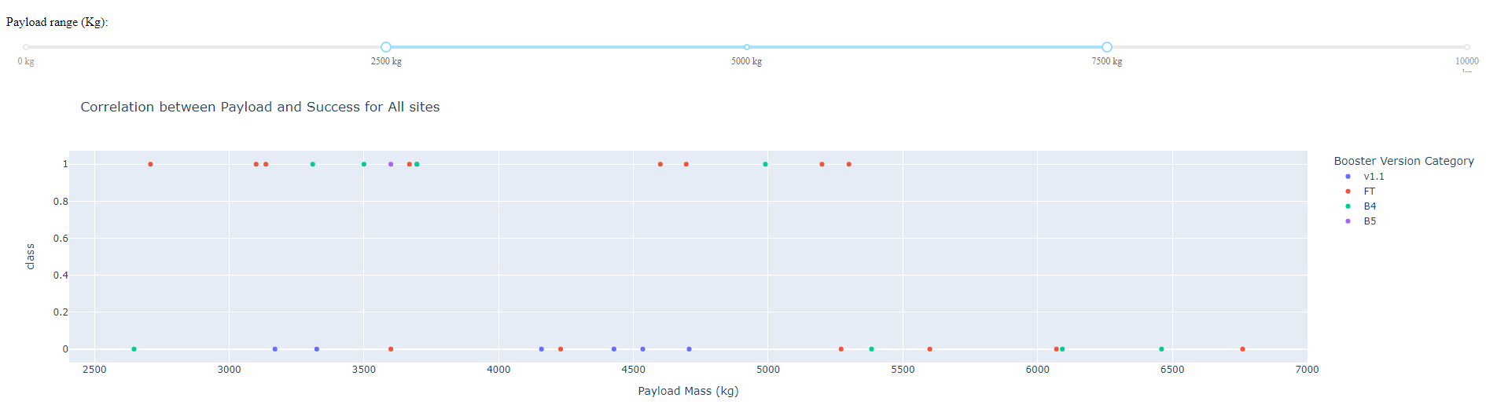
Payload vs Launch Outcome
These two charts show the success rate with different payload ranges. When the range is from 0-10,000kg Booster version v1.1 has the highest success.
However, when the payload range is from 2500-7500kg booster version FT has the highest success.

Slide 41


Slide 42
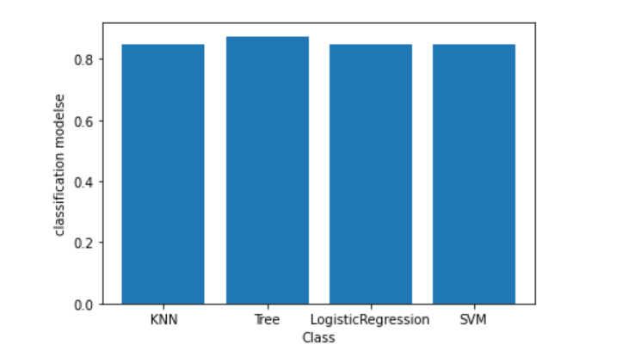
Classification Accuracy
Visualizing the accuracy of all the classification models we can see that the tree model has the highest accuracy.

Slide 43
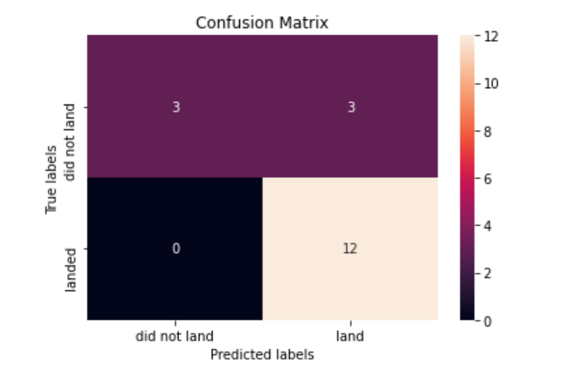
Confusion Matrix
The confusion matrix shows a total of 18 total test samples. Of the 18 test samples 12 of them landed.
With a small sample size, the confusion matrix for all the models was the same.

Slide 44
Conclusions
After the analysis we have determined that the payload is the most important factor in determining the success rate.
Knowing the payload lets us know which booster version will have the highest success rate.
There higher success rate brings down SpaceX’s overall cost per launch because they can reuse their first stage.

Slide 45


